Slide 1



Kinshasa Weather
View in Power BI
Last data refresh:
1/10/2023 11:42:56 AM UTC
Downloaded at:
1/10/2023 11:47:25 AM UTC

Slide 2
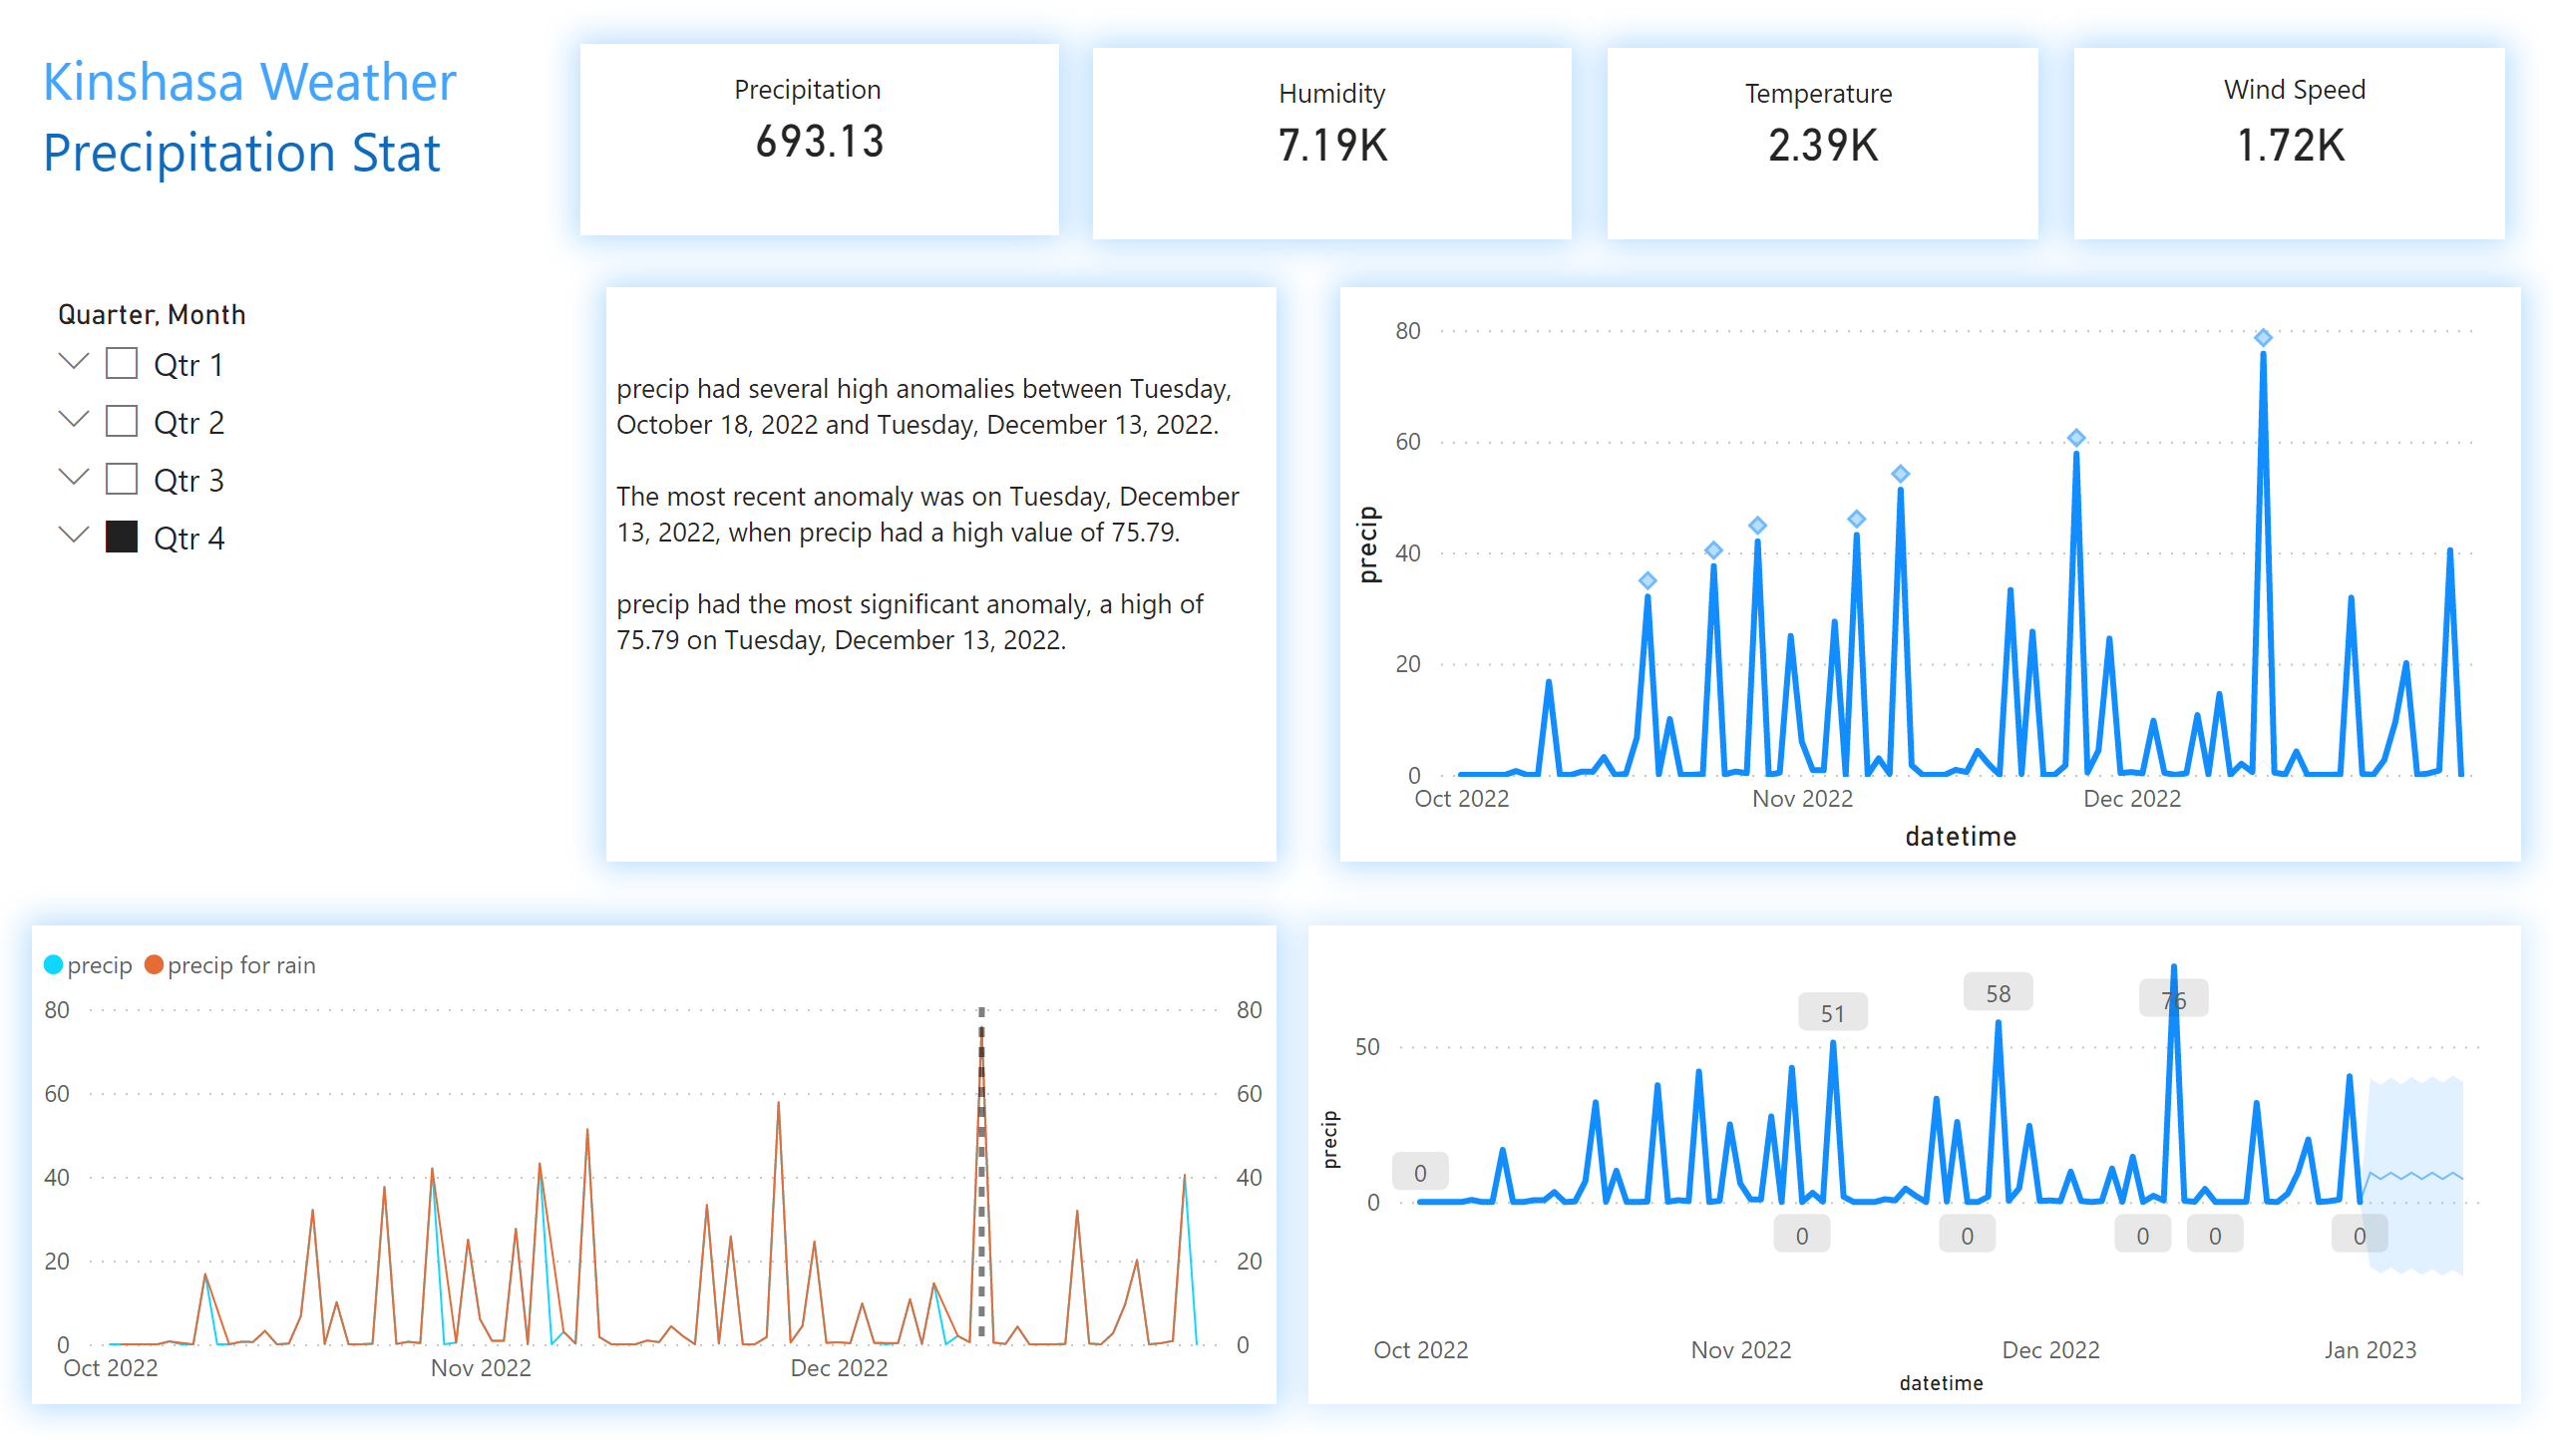
Kinshasa
Notes:
card
No alt text provided
card
No alt text provided
card
No alt text provided
card
No alt text provided
textbox
No alt text provided
textbox
No alt text provided
textbox
No alt text provided
textbox
No alt text provided
lineChart
No alt text provided
lineChart
No alt text provided
textbox
No alt text provided
lineChart
No alt text provided
textbox
No alt text provided
slicer
No alt text provided

Slide 3
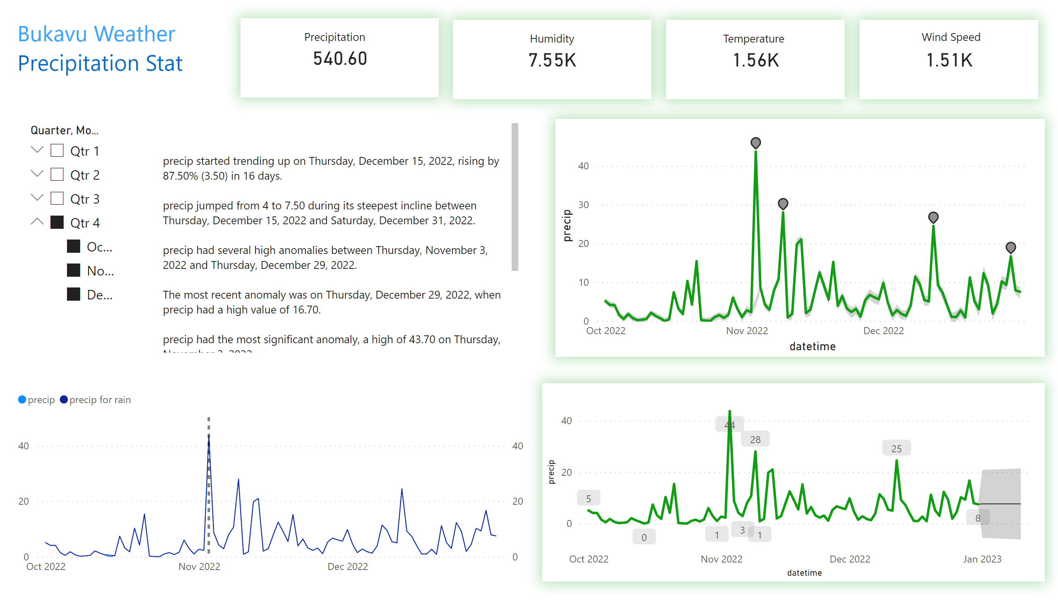
Bukavu
Notes:
card
No alt text provided
card
No alt text provided
card
No alt text provided
card
No alt text provided
textbox
No alt text provided
textbox
No alt text provided
textbox
No alt text provided
textbox
No alt text provided
lineChart
No alt text provided
lineChart
No alt text provided
textbox
No alt text provided
lineChart
No alt text provided
textbox
No alt text provided
slicer
No alt text provided

